Slide 1
Enabling Ontology-based Access to Streaming Data Sources
Venue here
Jean-Paul Calbimonte¹, Oscar Corcho¹, Alasdair J G Gray²
¹Ontology Engineering Group. Departamento de Inteligencia Artificial.
Facultad de Informática, Universidad Politécnica de Madrid.
Campus de Montegancedo s/n. 28660 Boadilla del Monte. Madrid. Spain
jp.calbimonte@upm.es;ocorcho@fi.upm.es
²School of Computer Science, The University of Manchester,
Oxford Road, Manchester M13 9PL, United Kingdom
a.gray@cs.man.ac.uk

Slide 2
Outline
Introduction & Motivation
Background
Approach
Mapping Streams to Ontologies
SPARQL Stream
Query Translation
Example
Future work
Conclusions

Slide 3
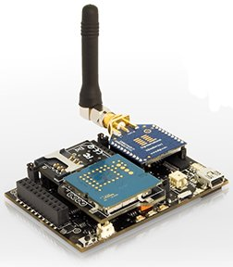
Introduction & Scope
Sensor technologies
Ubiquitous data capture
Data processing
Cheap
Noisy, Unreliable
Low computational, power resources, storage
Streaming Data
Continuously appended data
Potentially infinite
Time-stamped tuples
Continuous queries
Latest used in queries
(t9, a1, a2, ... , an)
(t8, a1, a2, ... , an)
(t7, a1, a2, ... , an)
...
...
(t1, a1, a2, ... , an)
...
...
Streaming Data
Applications in security surveillance, healthcare provision, environmental monitoring, you name it.

Slide 4
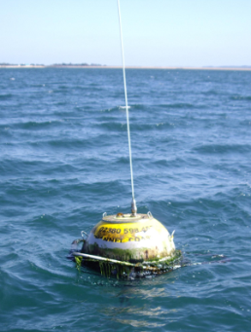
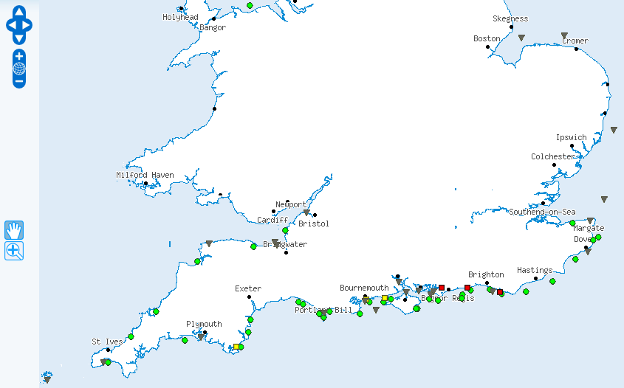




Motivation
Flood risk alert:
South East England
Wave,
Wind,
Tide
Real-time
data
Emergency planner
Meteorological forecasts
Flood defences data
Other sources
...
...
...
Detect conditions likely to cause a flood
Present data model in terms of the user domain: e.g. Flood risk assessment
Example:
“provide me with the wind speed observations average over the last minute in the Solent region, if it is higher than the average of the last 2 to 3 hours”

Slide 5
Motivation
Ontologies can be used as such a common model
Put something nice here
Answer the requirements:
Establish mappings between ontological models and streaming data source schemas
Access streaming data sources through queries over ontology models

Slide 6
Background – Ontology-based Data Access
Generate Semantic Web content from existing relational data sources
Ontological Models
R₂O + ODEMapster
D2RQ
SquirrelRDF
RDBToOnto
Relational.OWL
SPASQL
Virtuoso
MASTRO
e.g. SPARQL
Query/Data Transformation
Mapping
Document
Ontology-based Data Access
e.g. SQL
Relational
Schemas

Slide 7
Background – Querying Relational Data Streams
Streaming Data
Event Streams
Acquisitional Streams
STREAM
Aurora/Borealis
Cougar
TinyDB
SNEE
Query engines
e1
WINDOW [t_{now} TO t_{now-2}]
SLIDE 1
e1
e2
CQL
SNEEql
TinyQL
Query languages
e1
e2
e3
Transform infinite sequence of tuples to bounded bag
e1
e2
e3
e4
t
t+1
t+2
t+3
t+4
t+5
Window-to-Stream operators: convert stream of windows to stream of tuples
...
...

Slide 8
Ontology-based Streaming Data Access
SPARQL_{Stream} (O₁ O₂ O_{n})
q
Query
translation
Sensor Network (S₁)
SPARQL_{STR} (O_{g})
Query Evaluator
Relational DB (S₂)
Client
Stream-to-Ontology
mappings
SPARQL_{STR} algebra(S₁ S₂ S_{m})
Stream Engine (S₃)
RDF Store (S_{m})
Data
translation
Ontology-based Streaming Data Access Service

Slide 9
Ontology-based Streaming Data Access
Mappings from relational streams to ontological concepts
Extend stored data schema mappings
Study translation semantics
Provide with a stream query language at ontological level
Use notion of RDF stream
Extend SPARQL
Window operator, window-to-stream operators

Slide 10
SPARQL_{Stream}
Example:
“provide me with the wind speed observations over the last minute in the Solent Region ”
...
...
( <s_{i-1},p_{i-1}, o_{i-1}>, t_{i-1} ),
( <s_{i}, p_{i}, o_{i}>, t_{i} ),
( <s_{i+1},p_{i+1}, o_{i+1}>, t_{i+1} ),
...
...
RDF-Stream
Feature
locatedInRegion
xsd:float
Region
STREAM <http://www.semsorgrid4env.eu/ccometeo.srdf>
cd:Observation
PREFIX cd: <http://www.semsorgrid4env.eu/ontologies/CoastalDefences.owl#>
PREFIX sb: <http://www.w3.org/2009/SSN-XG/Ontologies/SensorBasis.owl#>
PREFIX rdf: <http://www.w3.org/1999/02/22-rdf-syntax-ns#>
SELECT ?waveheight ?wavets ?lat ?lon
FROM STREAM <http://www.semsorgrid4env/ccometeo.srdf>
WHERE
{
?WaveObs a cd:Observation;
cd:observationResult ?waveheight;
cd:observationResultTime ?wavets;
cd:observationResultLatitude ?lat;
cd:observationResultLongitude ?lon;
cd:observedProperty ?waveProperty;
cd:featureOfInterest ?waveFeature.
?waveFeature a cd:Feature;
cd:locatedInRegion cd:SouthEastEnglandCCO.
?waveProperty a cd:WaveHeight.
}
...
...
( <ssg4e:Obs1,rdf:type, cd:Observation>, t_{i} ),
( <ssg4e:Obs1,cd:observationResult,”34.5”>, t_{i} ),
( <ssg4e:Obs2,rdf:type, cd:Observation>, t_{i+1} ),
( <ssg4e:Obs2,cd:observationResult,”20.3”>, t_{i+1} ),
...
...
cd:observationResult
xsd:double

Slide 11
SPARQL_{Stream}
Example:
“provide me with the wind speed observations over the last minute in the Solent Region ”
PREFIX cd: <http://www.semsorgrid4env.eu/ontologies/CoastalDefences.owl#>
PREFIX sb: <http://www.w3.org/2009/SSN-XG/Ontologies/SensorBasis.owl#>
PREFIX rdf: <http://www.w3.org/1999/02/22-rdf-syntax-ns#>
SELECT ?waveheight ?wavets ?lat ?lon
FROM STREAM <http://www.semsorgrid4env.eu/ccometeo.srdf>
[ NOW – 1 MINUTE TO NOW – 0 MINUTES ]
WHERE
{
?WaveObs a cd:Observation;
cd:observationResult ?waveheight;
cd:observationResultTime ?wavets;
cd:observationResultLatitude ?lat;
cd:observationResultLongitude ?lon;
cd:observedProperty ?waveProperty;
cd:featureOfInterest ?waveFeature.
?waveFeature a cd:Feature;
cd:locatedInRegion cd:SouthEastEnglandCCO.
?waveProperty a cd:WaveHeight.
}
cd:Observation
cd:observationResult
cd:observedProperty
xsd:double
cd:Property
cd:featureOfInterest
cd:Feature

Slide 12
S2O Mappings
R2O extensions
put concept map def example, explain wirtual stream
Etc
Union thingy

Slide 13
Query Translation
Query mapping: formal thing
As algebra expressions with windows

Slide 14
Query Translation
example

Slide 15
So Far...
v
envdata_westbay
envdata_chesil
Feature
v
v
locatedInRegion
envdata_milford
Observation
v
S₂O
Mapping
hasObservationResult
Streams
envdata_hornsea
Ontologies
envdata_rhylflats
observedProperty
Region
Timestamp: long
Hs : float
Lon: float
Lat: float
xsd:float
WaveHeightProperty
PREFIX cd: <http://www.semsorgrid4env.eu/ontologies/CoastalDefences.owl#>
PREFIX sb: <http://www.w3.org/2009/SSN-XG/Ontologies/SensorBasis.owl#>
PREFIX rdf: <http://www.w3.org/1999/02/22-rdf-syntax-ns#>
SELECT ?waveheight ?wavets ?lat ?lon
FROM STREAM <http://www.semsorgrid4env/ccometeo.srdf>
WHERE
{
?WaveObs a cd:Observation;
cd:observationResult ?waveheight;
cd:observationResultTime ?wavets;
cd:observationResultLatitude ?lat;
cd:observationResultLongitude ?lon;
cd:observedProperty ?waveProperty;
cd:featureOfInterest ?waveFeature.
?waveFeature a cd:Feature;
cd:locatedInRegion cd:SouthEastEnglandCCO.
?waveProperty a cd:WaveHeight.
}
(SELECT Lon,timestamp,Hs,Lat FROM envdata_rhylflats) UNION
(SELECT Lon,timestamp,Hs,Lat FROM envdata_hornsea) UNION
(SELECT Lon,timestamp,Hs,Lat FROM envdata_milford) UNION
(SELECT Lon,timestamp,Hs,Lat FROM envdata_chesil) UNION
(SELECT Lon,timestamp,Hs,Lat FROM envdata_perranporth) UNION
(SELECT Lon,timestamp,Hs,Lat FROM envdata_westbay) UNION
(SELECT Lon,timestamp,Hs,Lat FROM envdata_pevenseybay)
SPARQL_{STR}
SNEEql

Slide 16
Implementation
Web service stuff, integration with SNEE, CCO live data

Slide 17
Implementation
Nice application using our thing

Slide 18
So Far…
Ontology-base data access
Define stream extensions for R2O
Define SPARQL_{STR} language syntax and semantics
Enable engine support for « S2O » documents, SPARQL_{STR} queries
Enabled engine support for SNEEql translation and connection
Limited to non-distributed scenario initially

Slide 19
Future Works
Ontology-based data access
SPARQL construct expressions, aggregates, projected operators
Implement adapters for other streaming sources
Add query rewriting algorithms
Ontology-based streaming data integration
Horizontal & vertical integration
Integrate streaming + stored data
RDF data sources integration
Streaming query optimization
Analyze cost models
Streaming sources statistics and metadata
Quantitative evaluation
19

Slide 20
Thanks!
Enabling Ontology-based Access to Streaming Data Sources

